Slide 1
Indexes & MongoDB
Urmil Shah

Slide 2
What is an index?
Creates a partial data set of the overall collection for faster data retrieval
Collections come with a default _id(mongoDB’s unique id) index
Shouldn’t create a lot of indexes as it can slow down the create/ delete/ update operations.

Slide 3
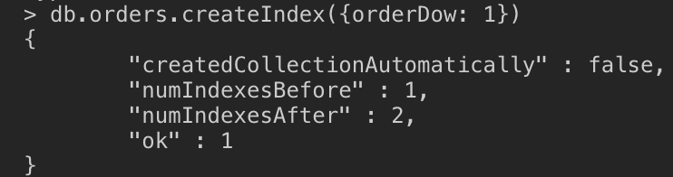
Create Index
The command is:
db.<collection>.createIndex({<fieldNames>: <Sort Order value>}, options)
Sort Order value example: 1 - Sort the data in ascending order
There is a multitude of different options available for customize the index. More info specifically for those could be found at https://docs.mongodb.com/manual/reference/method/db.collection.createIndex/#ensureindex-options

Slide 4
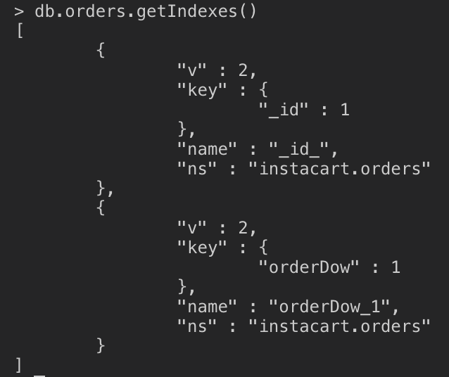

Get / Delete Indexes
Rather straight forward commands: getIndex() & dropIndex().
dropIndexes() is another method that will drop all indexes except the default _id index.

